Slide 1





Measuring Password Guessability
By: Farheen Ali

Slide 2
Do you use the same/similar password for multiple logins?

Slide 3
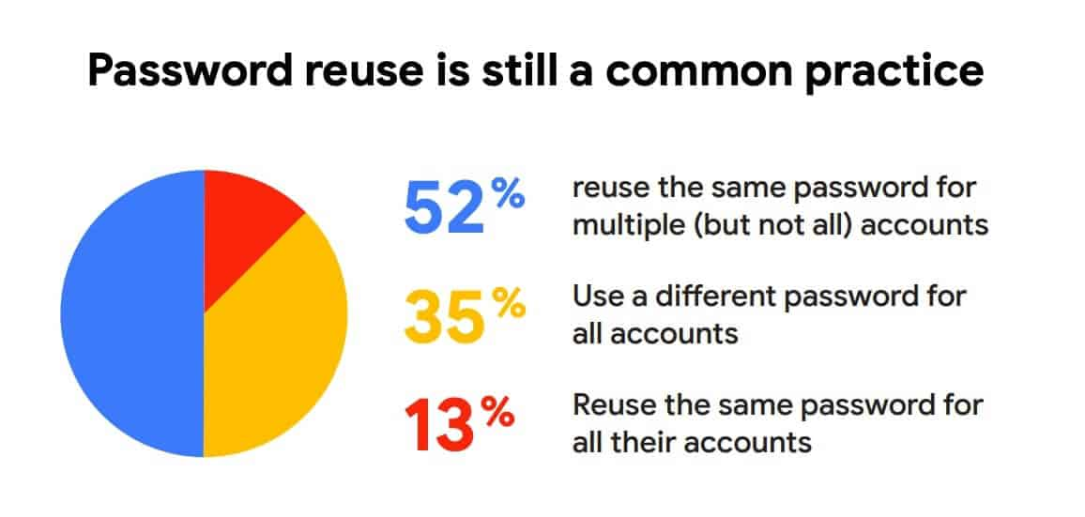

Slide 4
Introduction
Most common passwords
  12345, Password, qwerty
Statistics:
  80% of hacking incidents caused by stolen login info
  27% have tried to guess a user’s password
  17% of hackers have successfully guessed other’s password

Slide 5
Good Passwords vs Bad Passwords
Strong Password:
Mix of upper and lower case
Special characters
Numbers
No personal information
No dictionary words
Change passwords regularly
Weak Password:
Don’t reuse passwords
Don’t write passwords anywhere
Don’t share passwords
< 8 characters
Keyboard patterns*
Repeat characters

Slide 6
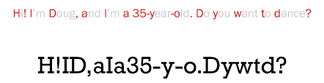
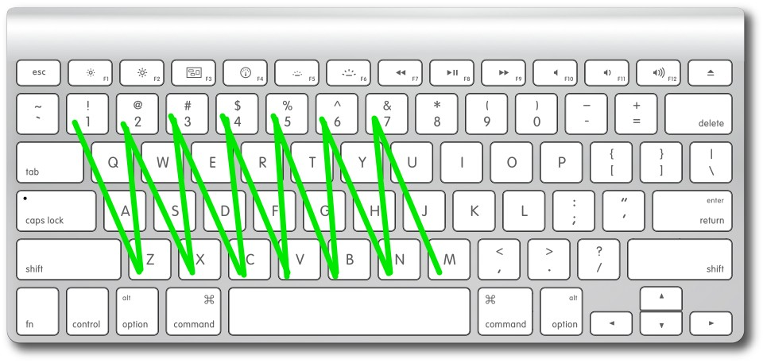
Strong Password Examples

Slide 7
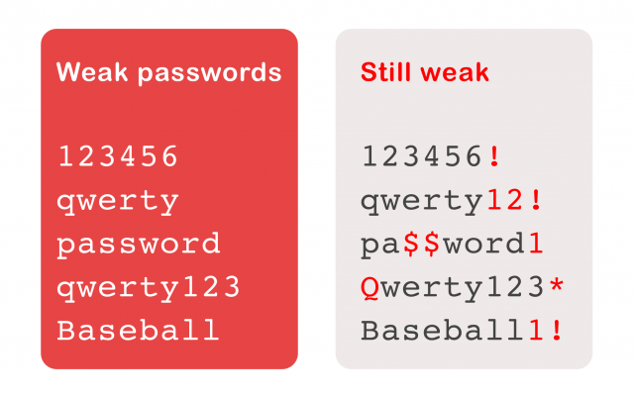
Bad Password Examples

Slide 8
Password Measurements

Slide 9
Password Measurement
Used to warn users
4 factors of a password:
  Length
  Variety
  Randomness
  Uniqueness

Slide 10

Shannon Entropy
Use: a measurement of unpredictable a password is
Example:
  “password”
  log2(26) = 4.7 bits
  4.7 * 8 = 37.6 bits

Slide 11
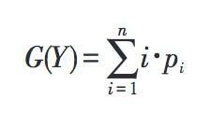
Guessing Entropy
Use: Measures the difficulty to guess the passwords
The expected number of guesses an attacker need in order to guess the password
Based on average size of passwords

Slide 12

Minimum Entropy
Use: a way to estimate the strength of the password
Relationship:
  Low strength password pb → low minimum entropy
Based on heuristics

Slide 13
THANK YOU!

Slide 14
Sources
https://www.comparitech.com/blog/information-security/password-statistics/
https://financesonline.com/password-statistics/
https://www.incognia.com/the-authentication-reference/what-makes-a-password-weak
https://seniorplanet.org/strong-passwords/
https://time.com/15908/best-password/
https://avelient.co/blog/how-to-make-strong-passwords-you-can-remember/
https://medium.com/asecuritysite-when-bob-met-alice/how-guessable-is-your-password-f0deeb69f985
https://www.okta.com/identity-101/password-entropy/
https://onestopdataanalysis.com/shannon-entropy/

